Slide 1

KNEE INJURY CLASSIFICATION
Presented by: Krishnan Narayanan
Palnati Neha Reddy
Vinisha Sunkara

Slide 2



INTRODUCTION
Knee injuries can really throw a wrench in our daily lives, making simple tasks like walking or climbing stairs a real challenge. MRI scans are essential for diagnosing these injuries, but interpreting them can be time-consuming and inconsistent among radiologists.
So, to improve this process, we propose an automated deep learning system that efficiently classifies knee injuries. Our approach integrates MRI slices from multiple planes—axial, coronal, and sagittal—to enhance diagnostic accuracy. This will help doctors make quicker and more reliable diagnoses, allowing patients to receive timely treatment and regain their mobility.

Slide 3

OBJECTIVE
We're developing a smart assistant for doctors to quickly identify knee injuries in MRI scans. Our system analyzes MRI slices from different angles to determine if there's an ACL tear, meniscus tear, or other abnormalities.
Here's how it works: We feed the computer lots of MRI slices - think of them as cross-sections of the knee from front-to-back, side-to-side, and top-to-bottom. The computer uses the deep learning part to understand what it's seeing in each slice. Then, it combines all this information using a method called logistic regression to make its final call on what type of injury it thinks it sees.

Slide 4
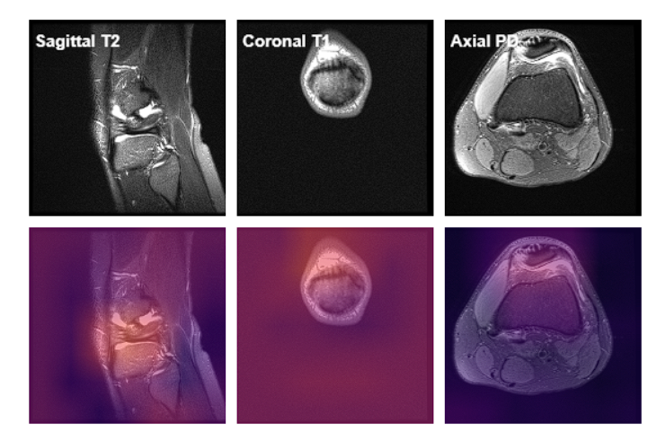
DATASET DESCRIPTION
The project utilizes the MRNet dataset, which comprises MRI scans from three anatomical planes.
This dataset has been prepared by Stanford ML group. It consists of 1,370 knee MRI exams performed at Stanford University Medical Center. The dataset contains 1,104 (80.6%) abnormal exams, with 319 (23.3%) ACL tears and 508 (37.1%) meniscal tears; labels were obtained through manual extraction from clinical reports.
Link: MRNet Dataset

Slide 5



The axial, sagittal, and coronal planes are essential for assessing various structures and potential tears.
Axial Plane: Provides cross-sectional views that are helpful in examining the patellar tendon, ligaments, and surrounding soft tissue structures.
Sagittal Plane: Offers a side view, which is valuable for evaluating ligament integrity, meniscal tears, and the alignment of knee structures.
Coronal Plane: Shows a front-facing view, useful for visualizing the menisci, collateral ligaments, and cartilage health.

Slide 6


METHODOLOGGY
Our approach starts by selecting the key slice from each MRI scan, ensuring we have the best view of the knee. We then enhance these images through resizing and normalization so our deep learning model can process them effectively.
For feature extraction, we use ResNet-18, a powerful convolutional neural network that’s been fine-tuned to analyze grayscale MRI images. We extract features separately from three different views of the knee: front, side, and top.
Finally, we combine these features using logistic regression, much like a team of experts collaborating to reach a conclusion. This multi-plane approach significantly improves our ability to accurately classify knee injuries, leading to faster and more reliable diagnoses for patients.

Slide 7

Data input
Preprocessing
FLOWCHART
ResNet Feature Extraction
Logistic Regression
Prediction Output

Slide 8


MODEL TRAINING
Our training process consists of two key steps:
Step 1: First, we train ResNet-18 on each MRI plane independently using binary cross-entropy loss, treating the classification as a multi-label problem. The model's convolutional layers are fine-tuned to learn meaningful patterns in the grayscale images.
Step 2: After extracting features from each view, we combine these insights into a single feature set. We then use logistic regression to weigh this combined information and make the final classification.This two-step approach ensures that each angle contributes uniquely to the overall prediction, enhancing the accuracy and reliability of our knee injury diagnoses.

Slide 9
RESULTS AND OBSERVATIONS
After running the model on the validation data, the model yielded good results in terms of performance metrics. We were able to achieve an AUC score of 0.9023, indicating the strength of the model in distinguishing different injury types effectively.
This system can be a very useful tool in medical diagnosis automation. Further testing on various datasets and real time clinical images might help validate its performance in a more practical setting.

Slide 10
DASHBOARD DEMO
To make the system accessible, we developed an interactive dashboard using Streamlit. The user uploads MRI slices from the axial, coronal, and sagittal planes, and the system outputs a classification result along with probabilities for each injury type. The dashboard also provides a diagnosis report, offering suggestions for treatment based on the predicted injury. For instance, an ACL tear prediction recommends consulting an orthopedic specialist, while a meniscus tear prediction suggests rest and physical therapy.

Slide 11
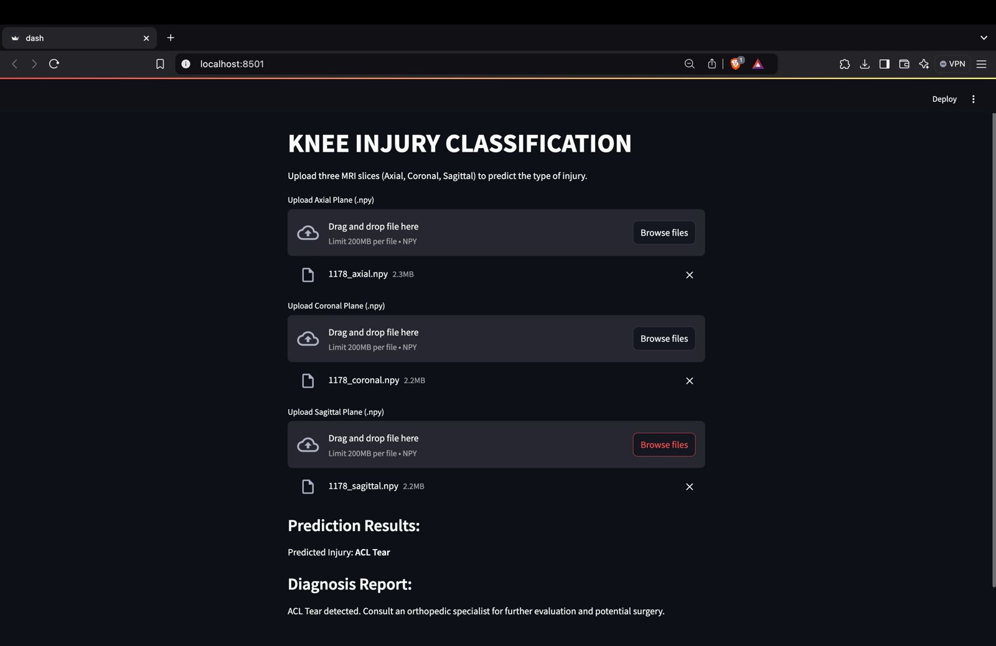

Slide 12
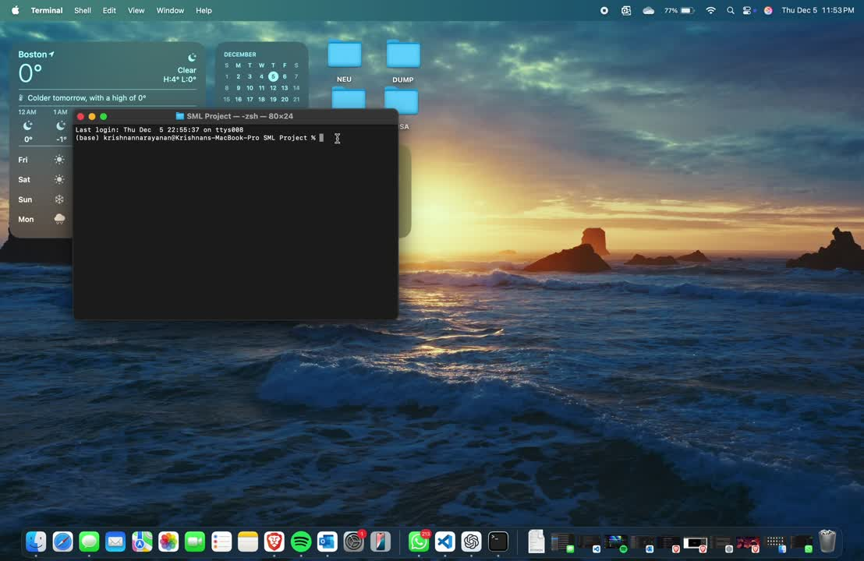

Slide 13
LIMITATIONS OF THE PROJECT
Although the model performs well, its limitations provide areas for improvement. The limited dataset does not reflect the high volume and diversity of clinical knee injury patients observed everyday, hence its generalizability to real-world situations is questionable. The overlap between injury classes, such as ACL and meniscus tears being labeled abnormal, makes classification difficult. This overlap highlights the need for stronger labels or frameworks to help the model distinguish injury types. The dashboard can only process one NPY image per plane, limiting its clinical usefulness. Batch processing multiple files, automatic image format conversion, and larger and more diverse sample sizes might reduce these concerns in subsequent improvements.

Slide 14

FUTURE WORK
Future enhancements to this project include expanding the dataset to improve generalization and incorporating advanced deep learning architectures, such as transformers, for better feature extraction. Additionally, we plan to extend the system to diagnose other joint injuries, enabling broader applicability in orthopedic imaging.

Slide 15
THANK YOU

